Slide 1
OOP USING JAVA

Slide 2
Programming Language
Unstructured Programming
Structured Programming Language
Object Oriented Programming

Slide 3
Unstructured Programming
There is no specific structure for this type programming language
programming languages having sequentially flow of control
Code is repeated through out the program
Example: BASIC, COBOL, FORTRAN

Slide 4
Structured Programming Languages
In this type of language, large programs are divided into small programs called functions.
Prime focus is on functions and procedures that operate on data
Data moves freely around the systems from one function to another
Example: C, Pascal, ALGOL and Modula-2

Slide 5
Object oriented programming language
In this type of language, programs are divided into objects
Prime focus is on the data that is being operated and not on the functions or procedures
Data is hidden and cannot be accessed by external functions
Example: C++, JAVA and C# (C sharp)

Slide 6
Introduction
Java is a programming language and a platform.
Java is a high level, robust, object-oriented and secure programming language .
Platform: Any hardware or software environment in which a program runs, is known as a platform.
Java platform is a collection of programs that help to develop and run programs written in the Java programming language.
Since Java has a runtime environment (JRE) and API, it is called a platform.

Slide 7
JAVA API
An application programming interface (API), in the context of Java, is a collection of prewritten packages, classes, and interfaces with their respective methods, fields and constructors .
In Java, most basic programming tasks are performed by the API’s classes and packages, which are helpful in minimizing the number of lines written within pieces of code.

Slide 8
Java Application
Desktop Applications such as acrobat reader, media player, antivirus, etc.
Web Applications such as irctc.co.in, .
Enterprise Applications such as banking applications.
Mobile
Embedded System
Smart Card
Robotics
Games, etc.

Slide 9
Java Platforms / Editions
There are 4 platforms or editions of Java

Slide 10
Standalone Application
Standalone applications are also known as desktop applications or window-based applications.
These are traditional software that we need to install on every machine.
Examples of standalone application are Media player, antivirus, etc.
AWT and Swing are used in Java for creating standalone applications

Slide 11
Web Application
An application that runs on the server side and creates a dynamic page is called a web application. Currently, Servlet, JSP, Struts, Spring, Hibernate, JSF, etc. technologies are used for creating web applications in Java.

Slide 12
Enterprise Application
An application that is distributed in nature, such as banking applications, etc. is called enterprise application.
It has advantages of the high-level security, load balancing, and clustering. In Java, EJB is used for creating enterprise applications

Slide 13
Mobile Application
An application which is created for mobile devices is called a mobile application. Currently, Android and Java ME are used for creating mobile applications.

Slide 14
Java SE (Java Standard Edition)
It is a Java programming platform.
It includes Java programming APIs such as java.lang, java.io, java.net, java.util, java.sql, java.math etc

Slide 15
Java EE (Java Enterprise Edition)
It is an enterprise platform which is mainly used to develop web and enterprise applications. It is built on the top of the Java SE platform.
It includes topics like Servlet, JSP, Web Services, EJB, JPA, etc.

Slide 16
Java ME (Java Micro Edition)
It is a micro platform which is mainly used to develop mobile applications .

Slide 17
JavaFX
It is used to develop rich internet applications.
It uses a light-weight user interface API.

Slide 18
History Of JAVA
James Gosling, Mike Sheridan, and Patrick Naughton initiated the Java language project in June 1991. The small team of sun engineers called Green Team.
Originally designed for small, embedded systems in electronic appliances like set-top boxes.
Firstly, it was called "Greentalk" by James Gosling, and file extension was .gt.
After that, it was called Oak and was developed as a part of the Green project.
In 1995, Oak was renamed as "Java" because it was already a trademark by Oak Technologies

Slide 19

James Gosling

Slide 20
Java Version History
JDK Alpha and Beta (1995)
JDK 1.0 (23rd Jan 1996)
JDK 1.1 (19th Feb 1997)
J2SE 1.2 (8th Dec 1998)
J2SE 1.3 (8th May 2000)
J2SE 1.4 (6th Feb 2002)
J2SE 5.0 (30th Sep 2004)
Java SE 6 (11th Dec 2006)
Java SE 7 (28th July 2011)
Java SE 8 (18th March 2014)
Java SE 9 (21st Sep 2017)
Java SE 10 (20th March 2018)
Java SE 11(25th Sep 2018)
Java SE 12(19th March 2019)
Java SE 13(17th Sep 2019)
Java SE 14(17th March 2020)
Java SE 15(16th Sep 2020)
Java SE 16(16th March 2021)
Java SE 17(14th Sep 2021)
Java SE 18(22nd March 2022)
Java SE 19(20th Sep 2022)
Java SE 20(21st March 2023)
Java SE 21(19th Sep2023)
Java SE 22(19th March 2024)
Java SE 23(Sep 2024)
Notes:
Java SE 8, 11, 17, 21 are all LTS (long term support), Older version still maintained

Slide 21
A simple Java Program
class Test{
public static void main(String args[]){
System.out.println("Hello Java");
}
}

Slide 22
Explanation of the Program
class keyword is used to declare a class in java.
public keyword is an access modifier which represents visibility. It means it is visible to all.
static is a keyword. If we declare any method as static, it is known as the static method. The core advantage of the static method is that there is no need to create an object to invoke the static method.
The main method is executed by the JVM, so it doesn't require to create an object to invoke the main method. So it saves memory.
void is the return type of the method. It means it doesn't return any value.
main represents the starting point of the program.
String[] args is used for command line argument. The main methodalways takes an array of strings.
System.out.println() is used to print statement. Here, System is a class, out is the object of PrintStream class, and a static member of System class. println() is the method of PrintStream class.

Slide 23
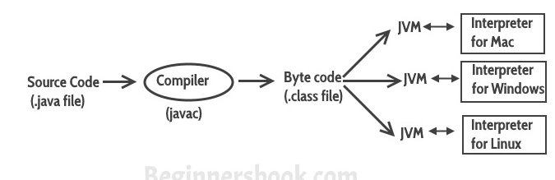

Slide 24
Step 1) Using the java compiler the code is converted into an intermediate code called the byte code. The output is a .class file.
Step 2) This code is not understood by any platform, but only a virtual platform called the Java Virtual Machine.
Step 3) This Virtual Machine resides in the RAM of your operating system.
When the Virtual Machine is fed with this byte code, it identifies the platform it is working on and converts the byte code into the native machine code.

Slide 25
Java Platform Independent?
Like C compiler, Java compiler does not produce native executable code for a particular machine.
Instead, Java produces a unique format called byte code.
Byte code is understandable to any JVM installed on any OS.
In short, the java source code can run on all operating systems.

Slide 26
Difference between JDK and JRE and JVM
JDK, JRE, and JVM are core concepts of Java programming language.

Slide 27
JDK
Java Development Kit is the core component of Java Environment and provides all the tools, executable and binaries required to compile, debug and execute a Java Program.

Slide 28
JDK
JDK is a platform-specific software and that’s why we have separate installers for Windows, Mac, and Unix systems.

Slide 29
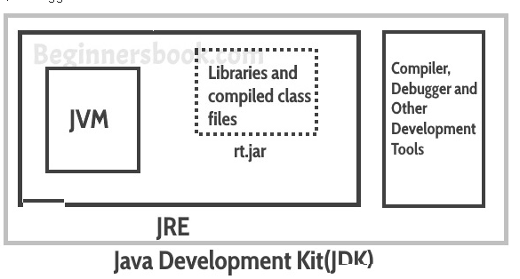
JDK

Slide 30
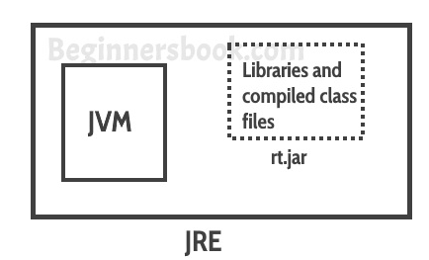
JRE

Slide 31
JRE
JRE: JRE is the environment within which the java virtual machine runs.
JRE contains Java virtual Machine(JVM), class libraries, and other files excluding development tools such as compiler and debugger. Which means we can run the code in JRE but we can’t develop and compile the code in JRE.

Slide 32
JVM
JVM runs the program by using class, libraries and files provided by JRE.

Slide 33
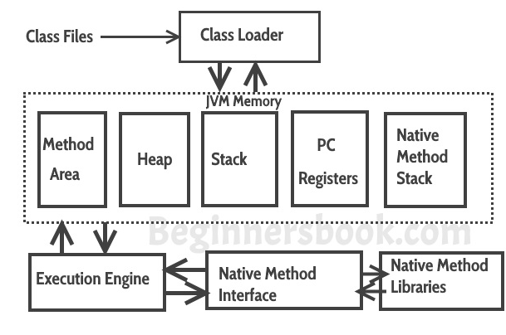
JVM

Slide 34
Software Code Compilation & Execution process
1) Editor – To type the program into, a notepad could be used for this
2) Compiler – To convert the high language program into native machine code
3) Linker – To combine different program files reference in the main program together.
4) Loader – To load the files from the secondary storage device like Hard Disk, Flash Drive, CD into RAM for execution. The loading is automatically done when the code is executed.
5) Execution – Actual execution of the code which is handled by the OS & processor.

Slide 35
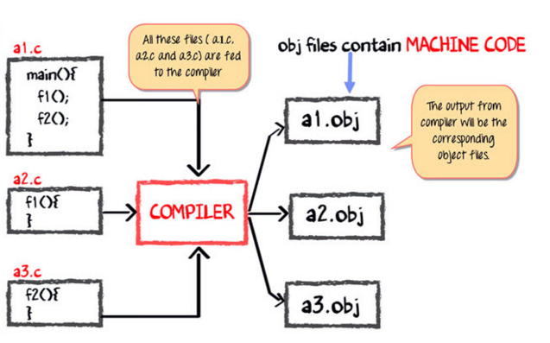
C code Compilation and Execution process

Slide 36
All these files, i.e., a1.c, a2.c, and a3.c, is fed to the compiler. Whose output is the corresponding object files which are the machine code .
The next step is integrating all these object files into a single .exe file with the help of linker. The linker will club all these files together and produces the .exe file
During program run, a loader program will load a.exe into the RAM for the execution.

Slide 37
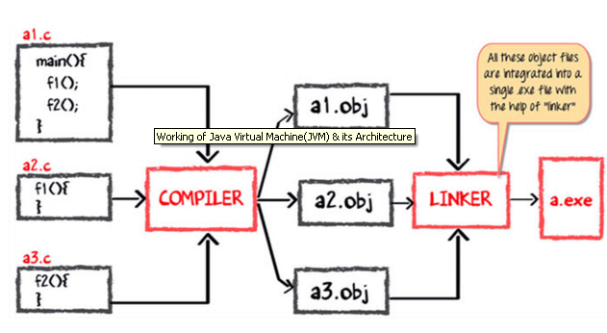

Slide 38
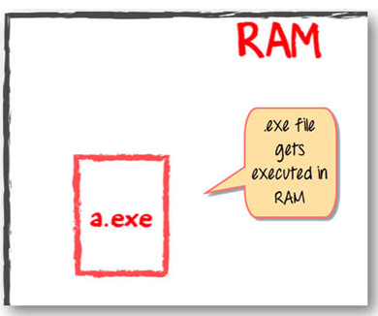

Slide 39
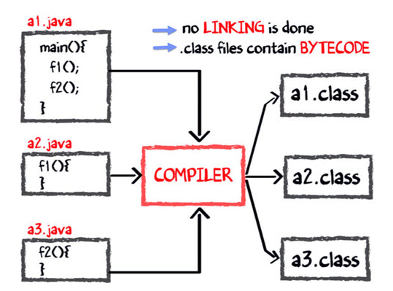
Java code Compilation and Execution in Java VM

Slide 40
The compiler will compile the three files and produces 3 corresponding .class file which consists of BYTE code. Unlike C, no linking is done.
The Java VM or Java Virtual Machine resides on the RAM. During execution, using the class loader the class files are brought on the RAM. The BYTE code is verified for any security breaches.
Next, the execution engine will convert the Bytecode into Native machine code. This is just in time compiling. It is one of the main reason why Java is comparatively slow.

Slide 41
Why is Java slow?
The two main reasons behind the slowness of Java are
Dynamic Linking: Unlike C, linking is done at run-time, every time the program is run in Java.
Run-time Interpreter: The conversion of byte code into native machine code is done at run-time in Java which furthers slows down the speed.

Slide 42
Summary
JVM or Java Virtual Machine is the engine that drives the Java Code. It converts Java bytecode into machines language.
JIT or Just-in-time compiler is the part of the Java Virtual Machine (JVM). It is used to speed up the execution time
In comparison to other compiler machines, Java may be slow in execution.

Slide 43
Features of Java(buzzwords )
Simple
Object-Oriented
Portable
Platform independent
Secured
Robust
Architecture neutral
Interpreted
High Performance
Multithreaded
Distributed
Dynamic

Slide 44
Simple
Java syntax is based on C++ (so easier for programmers to learn it after C++).
Java has removed many complicated and rarely-used features, for example, explicit pointers, operator overloading, etc.
There is no need to remove unreferenced objects because there is an Automatic Garbage Collection in Java.

Slide 45
Object-oriented
Java is an object-oriented programming language.
Everything in Java is an object. Object-oriented means we organize our software as a combination of different types of objects that incorporates both data and behavior.

Slide 46
Platform Independent
Java is platform independent because it is different from other languages like C, C++, etc.
which are compiled into platform specific machines while Java is a write once, run anywhere language.

Slide 47
Platform Independent
The Java platform differs from most other platforms in the sense that it is a software-based platform that runs on the top of other hardware-based platforms.
It has two components:
Runtime Environment
API(Application Programming Interface)

Slide 48
Secured
Java is best known for its security. With Java, we can develop virus-free systems. Java is secured because:
No explicit pointer
Java Programs run inside a virtual machine
Class loader
Bytecode Verifier:
Security Manager:

Slide 49
Robust
It uses strong memory management.
There is a lack of pointers that avoids security problems.
There is automatic garbage collection in java which runs on the Java Virtual Machine to get rid of objects which are not being used by a Java application anymore.
There are exception handling and the type checking mechanism in Java.

Slide 50
Architecture-neutral
Java is architecture neutral because there are no implementation dependent features, for example, the size of primitive types is fixed.
In C programming, int data type occupies 2 bytes of memory for 32-bit architecture and 4 bytes of memory for 64-bit architecture.
However, it occupies 4 bytes of memory for both 32 and 64-bit architectures in Java.

Slide 51
Portable
Java is portable because it facilitates us to carry the Java byte code to any platform.
It doesn't require any implementation

Slide 52
High-Performance
Java is faster than other traditional interpreted programming languages because Java bytecode is "close" to native code.

Slide 53
Distributed
Java is distributed because it facilitates users to create distributed applications in Java.
RMI and EJB are used for creating distributed applications.

Slide 54
Multi-threaded
A thread is like a separate program, executing concurrently.
We can write Java programs that deal with many tasks at once by defining multiple threads.
The main advantage of multi-threading is that it doesn't occupy memory for each thread. It shares a common memory area.

Slide 55
Dynamic
Java is a dynamic language. It supports dynamic loading of classes. It means classes are loaded on demand.
Java supports dynamic compilation and automatic memory management (garbage collection).

Slide 56
Object-oriented Programming Features
Basic concepts of OOPs are:
Object
Class
Inheritance
Polymorphism
Abstraction
Encapsulation

Slide 57
Class
Collection of similar types of objects is called class.
It is a logical entity.
Class doesn't consume any space.
A class is an entity that determines how an object will behave and what the object will contain.
In other words, it is a blueprint or a set of instruction to build a specific type of object.

Slide 58
Object
Object means a real-world entity such as a pen, chair, table, computer, watch, etc.
Any entity that has state and behavior is known as an object. For example, a chair, pen, table, keyboard, bike, etc. It can be physical or logical.
An Object can be defined as an instance of a class.
An object contains an address and takes up some space in memory.
An Object contains both the data and the function, which operates on the data.

Slide 59
Creating Object of a Class
Syntax:
ClassName objectname;
OR ClassName object name= new ClassName();

Slide 60
class <class_name>
{
field;
method;
}

Slide 61
Abstraction
Abstraction is selecting data from a larger pool to show only the relevant details to the object.
Abstraction is the process of selecting important data sets for an Object in your software and leaving out the insignificant ones.
It helps to reduce programming complexity and effort.
Abstraction is an act of representing essential features without including background details.

Slide 62
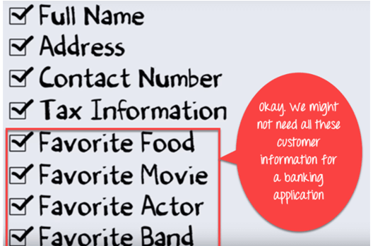
Abstraction

Slide 63
How to achieve Abstraction?
At a higher level, Abstraction is a process of hiding the implementation details and showing only functionality to the user.
It only indicates important things to the user and hides the internal details.
Abstract Class, Abstract Method

Slide 64
Inheritance
Inheritance is an OOPS concept in which one object acquires the properties and behaviors of the parent object.
It the process through which a new class is created from an existing class.
It’s creating a parent-child relationship between two classes.
It offers robust and natural mechanism for organizing and structure of any software.

Slide 65
Encapsulation
Encapsulation is a principle of wrapping data (variables) and code together as a single unit.
Java encapsulation is referred as data hiding.
To achieve a lesser degree of encapsulation in Java, you can use modifiers like "protected" or "public".

Slide 66
With encapsulation, developers can change one part of the code easily without affecting other.
Encapsulation is an OOP technique of wrapping the data and code.
In this OOPS concept, the variables of a class are always hidden from other classes.
It can only be accessed using the methods of their current class. For example - in school, a student cannot exist without a class.

Slide 67
Polymorphism
Polymorphism refers to the ability of a variable, object or function to take on multiple forms.
For example, in English, the verb run has a different meaning if you use it with a laptop, a foot race, and business.
Here, we understand the meaning of run based on the other words used along with it.
The same also applied to Polymorphism.
If one task is performed in different ways, it is known as polymorphism.

Slide 68
Variable
A variable can be thought of as a container which holds value for you, during the life of a Java program.
Every variable is assigned a data type which designates the type and quantity of value it can hold.

Slide 69
Variable Declaration:
int a,b,c;
float pi;
double d;
char a;

Slide 70
Types of variables
In Java, there are three types of variables:
Local Variables
Instance Variables
Static Variables

Slide 71
Local Variables
Local Variables are a variable that are declared inside the body of a method.

Slide 72
Instance Variables
Instance variables are defined without the STATIC keyword .
They are defined Outside a method declaration. They are Object specific and are known as instance variables.

Slide 73
Static Variables
Static variables are initialized only once, at the start of the program execution.
These variables should be initialized first, before the initialization of any instance variables.

Slide 74
Types of Variables in Java
Class Test
{
int data = 99; //instance variable
static int a = 1; //static variable
void method()
{
int b = 90; //local variable
}
}

Slide 75
Java Primitive Data Types
There are 8 types of primitive data types:
boolean data type
byte data type
char data type
short data type
int data type
long data type
float data type
double data type

Slide 76
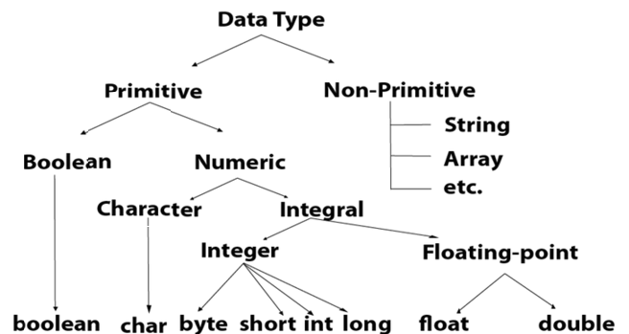
Data Types

Slide 77
Data Types in Java
Data types specify the different sizes and values that can be stored in the variable. There are two types of data types in Java:
Primitive data types: The primitive data types include boolean, char, byte, short, int, long, float and double.
Non-primitive data types: The non-primitive data types include Classes, Interfaces, and Array.

Slide 78
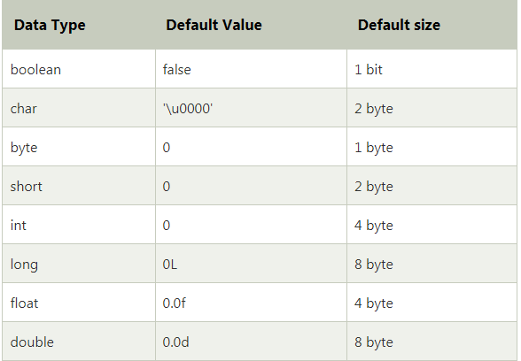

Slide 79
Boolean Data Type
The Boolean data type is used to store only two possible values: true and false.
Example:
Boolean b = false;

Slide 80
Byte Data Type
Its value-range lies between -128 to 127 (inclusive). Its minimum value is -128 and maximum value is 127.
Its default value is 0.
Example:
byte a = 10;
byte b = -20;

Slide 81
Short Data Type
Its value-range lies between -32,768 to 32,767 (inclusive).
Example: short s = 10000;
short r = -5000;

Slide 82
Int Data Type
Its default value is 0.
Example:
int a = 10;
int b = -20 ;

Slide 83
Long Data Type
Its default value is 0.
Example:
long a = 100000L;
long b = -200000L;

Slide 84
Float Data Type
Its default value is 0.0F.
Example:
float f1 = 234.5f;

Slide 85
Double Data Type
Its default value is 0.0d.
Example:
double d1 = 12.3;

Slide 86
Char Data Type
The char data type is used to store characters.
Example:
char var = 'A‘;

Slide 87
Why char uses 2 byte in java ?
It is because java uses Unicode system not ASCII code system.
Unicode is a universal international standard character encoding that is capable of representing most of the world's written languages.

Slide 88
Other language standards
ASCII (American Standard Code for Information Interchange) for the United States.
ISO 8859-1 for Western European Language.
KOI-8 for Russian.
GB18030 and BIG-5 for chinese, and so on.

Slide 89
Operator
Operator in java is a symbol that is used to perform operations. For example: +, -, *, / etc.

Slide 90
Operator
Unary Operator,
Arithmetic Operator,
Shift Operator,
Relational Operator,
Bitwise Operator,
Logical Operator,
Ternary Operator and
Assignment Operator.

Slide 91
Other Operators
New [],instanceof
Example
Pizza one =new Pizza();
Int[] a1=new int[5];
A1[4]=a1[3];
Boolean t1=one instanceof pizza;

Slide 92
Java Comments
Types of Java Comments
There are 3 types of comments in java.
Single Line Comment
Multi Line Comment
Documentation Comment

Slide 93
Java Comment
//This is single line comment
/*
This
is
multi line
comment
*/
/**
This
is
documentation
comment
*/
The documentation comment is used to create documentation API. To create documentation API, you need to use javadoc tool.

Slide 94
Java If-else Statement
The Java if statement is used to test the condition. It checks boolean condition: true or false. There are various types of if statement in java.
if statement
if-else statement
if-else-if ladder
nested if statement

Slide 95
Small program using switch case
class SwitchCaseDemo
{
public static void main(String args[])
{
int ch = 5;
switch (ch)
{
case 0:
System.out.println(“ch is zero.");
break;
case 1:
System.out.println(“ch is one.");
break;
case 2:
System.out.println(“ch is two.");
break;
default:
System.out.println(“ch is greater than 2.");
}
}}

Slide 96
Loops in Java
In programming languages, loops are used to execute a set of instructions/functions repeatedly when some conditions become true. There are three types of loops in java.
for loop
while loop
do-while loop

Slide 97
Jump Statements
If we require to transfer the control of the program to some specific statements by skipping some lines of code in between, there we use jump statements.
There are three types of jump statements in Java such as
Break.
Continue.
Return.

Slide 98
break statement
It is used to terminate a loop or case of a switch statement.
In nested loops it is used to terminate the innermost loop.
In a loop it can be written with a condition.
Example:
class BreakDemo
{
public static void main(String args[])
{
for (int i = 1; i < 10; i++)
{
if (i == 4) break;
System.out.println ("i: " + i);
}
}
}
Output: i: 1
i: 2
i: 3

Slide 99
Using Break as a Form of Goto
Java doesn’t have goto statement. But, the properties of goto can be achieved by using break statement with labels.
Syntax:
label:
{
statement1;
statement2;
statement3;
. .
}
break label;

Slide 100
Example:
class BreakLabelDemo
{
public static void main(String args[])
{
boolean t = true;
first:
{
second:
{
System.out.println("Before break statement");
if (t)
break second;
System.out.println("This won't execute.");
}
System.out.println(“Hello.");
}
System.out.println(“After second block.");
}
}
Output: Before break statement
Hello
After second block.

Slide 101
Continue Statement
Sometimes we may want to continue running the loop without executing the rest of the code in its body for this particular iteration. There we can use this continue statement.
Like break, continue also can only be present inside a loop with a condition.
Example:
class ContinueDemo
{
public static void main(String args[])
{
for (int i = 1; i < 10; i++)
{
if (i%3== 0) continue;
System.out.print(i + " ");
}
}
}
Output: 1 2 4 5 7 8

Slide 102
return statement
The return statement is used to return from a method.
Compiler will bypass every statement after the return.
Example:
class Return
{
public static void main(String args[])
{
boolean b = true;
System.out.println(“Hello");
if (b)
return;
System.out.println(“Hi");
}
}
Output: Hello

Slide 103
Type Casting in Java
When we want to change the type of a variable to another type we use type casting.
In Java two types of type casting is possible.
Widening Casting (Automatically) - converting a smaller type to a larger type.
byte -> short -> char -> int -> long -> float -> double.
Narrowing Casting (Manually) - converting a larger type to a smaller type. double -> float -> long -> int -> char -> short -> byte.

Slide 104
Widening Casting (Automatically)
Widening casting is done automatically when passing a smaller size type to a larger size type.
Example:
class WideningCast
{
public static void main(String[] args)
{
int a = 7;
double b= a; // Automatic casting: int to double
System.out.println(a);
System.out.println(b);
}
}
Output: 7
7.0

Slide 105
Narrowing Casting (Manually)
Narrowing casting must be done manually by placing the type in parentheses in front of the value.
Example:
public class NarrowingCast
{
public static void main(String[] args)
{
double b = 5.78d;
int a = (int) b; // Manual casting: double to int
System.out.println(b);
System.out.println(a);
}
}
Output: 5.78
5

Slide 106
Array
An array is a very common type of data structure where in all elements must be of the same data type.
Once defined, the size of an array is fixed and cannot increase to accommodate more elements.
Array in Java also index-based, the first element of the array is stored at the 0th index, 2nd element is stored on 1st index and so on.

Slide 107
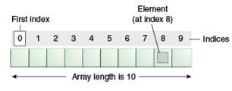

Slide 108
x[0]=0;
x[1]=1;
x[2]=2;
x[3]=3;
x[4]=4;
x[5]=5;

Slide 109
Types of Array in java
There are two types of array.
Single Dimensional Array
Multidimensional Array

Slide 110
Single Dimensional Array in Java
dataType[] arr; (or)
dataType []arr; (or)
dataType arr[];

Slide 111
Example
int Arr[];
// Defines that Arr is an ARRAY variable which will store integer values
Also int []Arr;

Slide 112
Instantiation of an Array in Java
arrayname = new dataType[]
Example
Arr= new int[10];
Declaration and Construction combined
int Arr[] = new int[10];

Slide 113
Initialize an Array
Arr[0]=1;
// Assigns an integer value 1 to the first element 0 of the array
Arr1]=2;

Slide 114
Example of Java Array
class Testarray{
public static void main(String args[]){
int a[]=new int[5];//declaration and instantiation
a[0]=10;//initialization
a[1]=20;
a[2]=70;
a[3]=40;
a[4]=50;
//traversing array
for(int i=0;i<a.length;i++)
//length is the property of array
System.out.println(a[i]);
}
}

Slide 115
Declaration, Instantiation and Initialization of Java Array
int a[]={33,3,4,5};
float salary[]=new float[50];
char ch[]={‘a’,’b’,’c’};
char ch[]=new char[10];
String names[]={“raju”};
String names[]=new String[10];

Slide 116
class Testarray1{
public static void main(String args[]){
int a[]={33,3,4,5};//declaration and initialization
//printing array
for(int i=0;i<a.length;i++)//length is the property of array
System.out.println(a[i]);
}
}

Slide 117
For-each Loop for Java Array
for(data_type variable:array){
//body of the loop
}

Slide 118
Example:
class Testarray1{
public static void main(String args[]){
int arr[]={33,3,4,5};
//printing array using for-each loop
for(int i:arr)
System.out.println(i);
}
}

Slide 119
Multidimensional Array in Java
dataType[][] arrayRefVar; (or)
dataType [][]arrayRefVar; (or)
dataType arrayRefVar[][]; (or)
dataType []arrayRefVar[];

Slide 120
Passing Array to a Method in Java
class Testarray2{
//creating a method which receives an array as a parameter
static void min(int arr[]){
int min=arr[0];
for(int i=1;i<arr.length;i++)
if(min>arr[i])
min=arr[i];
System.out.println(min);
}
public static void main(String args[]){
int a[]={33,3,4,5};//declaring and initializing an array
min(a);//passing array to method
}
}

Slide 121
Example to instantiate Multidimensional Array in Java
int[][] arr=new int[3][3];//3 rows and 3 columns

Slide 122
arr[0][0]=1;
arr[0][1]=2;
arr[0][2]=3;
arr[1][0]=4;
arr[1][1]=5;
arr[1][2]=6;
arr[2][0]=7;
arr[2][1]=8;
arr[2][2]=9;

Slide 123
Example
public class Test {
public static void main(String[] args)
{
// Create 2-dimensional array.
int[][] twoD = new int[4][4];
// Assign three elements in it.
twoD[0][0] = 1;
twoD[1][1] = 2;
twoD[3][2] = 3;
System.out.print(twoD[0][0] + " ");
}
}

Slide 124
Example:
class Testarray3
{
public static void main(String args[]){
//declaring and initializing 2D array
int arr[][]={{1,2,3,4},{2,4,5,6},{4,4,5,7}};
//printing 2D array
for(int i=0;i<3;i++){
for(int j=0;j<4;j++){
System.out.print(arr[i][j]+" ");
}
System.out.println();
}
}
}

Slide 125
Multiplication of two matrices
import java.util.Scanner;
class Matrixadd {
public static void main(String[] args) {
int a[][]=new int[10][10];
int b[][]=new int[10][10];
int c[][]=new int[10][10];
int m,n,p,q;
Scanner sc=new Scanner(System.in);
System.out.println("Enter the no of rows in the 1st matrix");
m=sc.nextInt();
System.out.println("Enter the no of columns in the 1st matrix");
n=sc.nextInt();
System.out.println("Enter the no of rows in the 2nd matrix");
p=sc.nextInt();
System.out.println("Enter the no of columns in the 2nd matrix");
q=sc.nextInt();

Slide 126
if(n!=p) {
System.out.println("Matrix cant be multiplied");
}
else {
System.out.println("Enter the elements in the 1st matrix");
for(int i=0;i<m;i++) {
for (int j=0;j<n;j++) {
a[i][j]=sc.nextInt();
} }
System.out.println("The elements in the 1st matrix are ");
for(int i=0;i<m;i++) {
for (int j=0;j<n;j++) {
System.out.print(a[i][j]+" "); }
System.out.println();
}

Slide 127
System.out.println("Enter the elements in the 2nd matrix");
for(int i=0;i<p;i++) {
for (int j=0;j<q;j++) {
b[i][j]=sc.nextInt();
}
}
System.out.println("The elements in the 2nd matrix are "); for(int i=0;i<p;i++) {
for (int j=0;j<q;j++) {
System.out.print(b[i][j]+" ");
}
System.out.println();
}

Slide 128
for(int i=0;i<m;i++) {
for (int j=0;j<q;j++) {
c[i][j]=0;
for(int k=0;k<p;k++) {
c[i][j]=c[i][j]+a[i][k]*b[k][j];
}
}
}
System.out.println("The resultant matrix is");
for(int i=0;i<m;i++) {
for (int j=0;j<q;j++) {
System.out.print(c[i][j]+" ");
}
System.out.println();
}
}
}
}

Slide 129
Class Fundamentals
A class is a template or blueprint from which the objects are created.
A class definition is exceptionally almost like a structure definition.
Syntax:
class class_name
{
Variables;
Methods;
}
Here, class_name is an identifier. The variables and methods can have public, Private, Protected or Default access specifics.

Slide 130
Access Specifiers/Visibility labels
An access specifier is a key -word that specifies the way to access -the members of a class. We can use access specifiers before a class and its members.
There are four access specifiers available in Java:
Private: 'private' members of a-class are accessible only inside the class by the methods of that class.
Public: 'public' members of a class are accessible every where outside the class. So the other program can read them and use them.
Protected: 'protected' members of a class are accessible outside the class definition by the subclasses, also within the same package by other classes or methods and outside the package by the subclasses only.
Default: If no access specifier is written by the programmer, then, the Java compiler uses a 'default' access specifier. 'default' members are accessible outside the class, but within the same package.

Slide 131
Object Creation
Objects of a class can be created in two different ways:
1.Using ‘new’ operator
Syntax:- classname objectname=new classname();
Example:- The object of Demo class can be created as
Demo d=new Demo();
2. Using class name itself
Syntax:- classname objectname;
Example:- Demo d;

Slide 132
Initialising The Instance Variables
The instance variables of a class are initialised in three ways:
By using the object of the class inside the body of the main() method.
By using the method of the same class to which the variables belong.
Inside the class within which they are declared.
By using the object of the class inside the body of the main() method
Instance variables of a class are initialised by using the object of the class if and only if they are not private.
Because, private member of a class can’t be accessed by the object of the class.

Slide 133
Example:-
class Person
{
int age;
String name;
void display()
{
System.out.println("The information of the person is ");
System.out.println("Name is " + name);
System.out.println("Age is " + age);
}
}
class Demo5
{
public static void main(String args[])
{
Person P=new Person(); // object is created
P.name=“Robin"; // if the members aren't private then do in this way
P.age=26;
P.display(); // displays the output
}
}

Slide 134
By Using the Method of the Same Class to Which the Variables Belong
The instance variables of a class can be initialised by using the method of the same class as follows:
Example:-
class Person
{
private int age;
private String name;
void input()
{
age=26;
name=“Robin";
}

Slide 135
void display()
{
System.out.println("The information of the person is ");
System.out.println("Name is " + name);
System.out.println("Age is " + age);
}
}
class Demo4
{
public static void main(String args[])
{
Person P=new Person(); // object is created
P.input(); //take input
P.display(); // displays the output
}
}

Slide 136
Inside the Class Within Which they are Declared
Instance variables can also be initialised at the time of declaration inside a class definition as follows:
Example:-
class Person
{
int age=26;
String name=“Robin";
void display()
{
System.out.println("The information of the person is ");
System.out.println("Name is " + name);
System.out.println("Age is " + age);
}}
class Demo6
{
public static void main(String args[])
{
Person P=new Person(); // object is created
P.display(); // displays the output
}}

Slide 137
Instance Methods
Instance methods are the methods acting on the instance variables of the class.
To call the instance methods, we should use the syntax:
objectname.methodname().
For example:- P.display();

Slide 138
Constructors
Constructors are unique methods as they use the name of the class as their names.
Constructors are used for initialising the data members of a class.
Since it constructs the value of the data members hence, the name constructor.
They don’t have a return type, not even void.
Constructor is automatically called/executed at the time of creating an object.
Constructor is called and executed only once per object.
Constructors may or may not take arguments or parameters.

Slide 139
Types of Constructors
Default Constructor
Constructor that does not take any argument or parameter is called as default constructor.
Example:-
For a class Demo the default constructor can be defined as follows:
Demo()
{
}
Default constructor is called automatically when the object of a class is made.

Slide 140
Example
class Person{
int age;
String name;
Person() // definition of a default constructor
{
age=26;
name=”Robin”;
}
void display()
{
System.out.println("The information of the person is ");
System.out.println("Name is " + name);
System.out.println("Age is " + age);
}
}

Slide 141
class Demo7{
public static void main(String args[])
{
Person P=new Person(); // default constructor is called and the instance variables gets initialised
P.display(); // displays the output
}
}

Slide 142
Parameterised Constructor
Constructor that takes argument or parameter is called parameterised constructor.
Example:-
Demo(String s, int a)
{
name=s;
age=a;
}
It is invoked or called automatically, when the object of a class is created by passing arguments.

Slide 143
Example
class Person
{
int age;
String name;
Person(String s, int a)
{ // definition of a parameterised constructor
age=a;
name=s;
}
void display()
{
System.out.println("The information of the person is ");
System.out.println("Name is " + name);
System.out.println("Age is " + age);
}}

Slide 144
class Demo8
{
public static void main(String args[])
{
Person P1=new Person(“Robin”,20); // parameterized constructor
is called
P1.display(); // displays the info of the 1st object
Person P2=new Person(“Jerrin”,30);
P2.display(); // displays the info of the 2nd object
}
}

Slide 145
Constructor Overloading
Defining multiple constructors in a class, each with different signature is called constructor overloading.
Example:
class Circle
{
int radius;
Circle(){}
Circle(int r)
{
radius=r;
}
}

Slide 146
WAP to calculate area of a circle by overloading constructor.
class Circle{
double rad,Area;
Circle()
{
}
Circle(double r)
{
rad=r;
}
void display()
{
Area=3.141*rad*rad;
System.out.println("Area of circle="+ Area);
}
}

Slide 147
class Test
{
public static void main(String[] args)
{
Circle c=new Circle(4.5);
c.display();
}
}
Output:
Area of circle=63.60525

Slide 148
Assigning Object Reference Variables
Object reference variables act differently than we would expect when an assignment takes place.
For example,
Box b1 = new Box();
b1
Box b2 = b1;
b1
b2
Here, b2 is assigned a reference to the exact copy of the object referred to by b1. That means b1 and b2 will both refer to the same object. This assignment did not allocate any memory or copy any part of the original object.
It simply makes b2 refer to the same object as does b1. Thus, any changes made to the object through b2 will also affect the object to which b1 refers since they are the same object. Like this, we can create multiple references to the same object.
Box object
Box object

Slide 149
class Demo{
int dat1;
int dat2;
}
public class Java_app {
public static void main(String[] args) {
Demo d1 = new Demo();
d1.dat1 = 20;
Demo d2 = d1;
d2.dat2 = 50;
Demo d3 = d2;
System.out.println("d3.dat1 : "+d3.dat1);
System.out.println("d3.dat2 : "+d3.dat2);
}
}
Here, d1,d2 and d3, all the three data class objects refer to the same Data object. Hence, any change made to data1 or data2 through either object will reflect all of them.
N.B
When you assign one object reference variable to another object reference variable, you are not creating a copy of the object, and you are only making a copy of the reference.
Output:
d3.dat1 :20
d3.dat2 :50

Slide 150
this and this() in Java
In Java, both this and this () are entirely different from each other.
‘this’ keyword refers to the current object, through which the method is called.
This keyword can be used with variables, methods and with classes.
this() is used to call one constructor from the other of the same class.

Slide 151
Difference Between this and this() in Java
this | this()
‘this’ keyword is used with the objects only. | this() is used with constructors only.
It refers to the current object. | It refers to the constructor of the same class whose parameters matches with the parameters passed to this (parameters).
Dot (.) operator is used to access the members. For example, this.variablename; | No Dot (.) operator is used. Only the matching parameters are passed.
It is used to differentiate between the local variable and the instance variable in the method. | It is used to refer to the constructor belonging to the same class.

Slide 152
Use of ‘this’ keyword
class Stud
{
private String name;
private int age;
Stud(String s, int a)
{
this.name = s;
this.age = a;
}
void show()
{
System.out.println("Name = " + this.name);
System.out.println("Age = " + this.age);
}
public static void main(String[] args)
{
Stud st= new Stud(“Aryan", 28);
st.show();
}
}
Output: Name = Aryan, Age = 28

Slide 153
Use of ‘this()’
class Stud
{
private String name;
private int age;
Stud(String s)
{
this(28);
System.out.println ("Name of Student : " + s);
}
Stud(int a)
{
System.out.println("Age of student = " + a);
}
}
class Dem
{
public static void main(String args[])
{
Stud st= new Stud(“Aryan”);
}
}
Output: Age of student = 28
Name of Student : Aryan

Slide 154
Final Keyword
Final is a reserved word in java. We can’t use it as an identifier as it is a keyword.
The final keyword in java when applied to variable, class or methods has got different meanings.

Slide 155
Final with Variables
The value of variable cannot be changed once initialised.
Example:
class A
{
public static void main(String[] args)
{
int b = 5;
final int c = 6;
}
b++;
c++;
}
}
Output: Compile time error
N.B:
If we declare any variable as final, we can’t modify its contents since it is final, and if we modify it then we get Compile Time Error.

Slide 156
Final with Class
Whenever we declare any class as final, it means that we can’t extend that class or we can’t make subclass of that class.
Example:
final class PP {
public static void main(String[] args)
{
int b = 10;
}
}
class SS extends PP
{
// more code here with main method
}
Output: Compile time error
N.B:
We can't extend RR as it is final.

Slide 157
Final with Method
The method cannot be overridden by a subclass. Whenever we declare any method as final, then it means that we can’t override that method.
Example:
class RR
{
final void pp() {}
public static void main(String[] arg)
{
}
}
class SS extends RR
{
void pp() {}
}
Output: Compile time error
N.B :
If a class is declared as final then by default all of the methods present in that class are automatically final but variables are not.

Slide 158
Finaliser Method
Finalisation is a concept just opposite to initialisation.
The resources which are not released automatically like file descriptors or window system fonts are freed by using the finaliser method.
It is similar to a detsructor in C++.
The finaliser method is just the finalise() method added to any class.
This method explicitly defines the task that is to be performed.

Slide 159
Passing and Returning Objects in Java
When we pass an object to a method, it is called passed by reference.
Example:
class ObjectPassing
{
int a, b;
ObjectPassing(int i, int j)
{
a = i;
b = j;
}
boolean equalTo(ObjectPassing o)
{
return (o.a == a && o.b == b);
}
}

Slide 160
class Test
{
public static void main(String args[])
{
ObjectPassing o1 = new ObjectPassing (10, 20);
ObjectPassing o2 = new ObjectPassing (10, 20);
ObjectPassing o3 = new ObjectPassing (-2, -2);
System.out.println(“o1 = = o2: " + o1.equalTo(o2));
System.out.println("o1 = = o3: " + o1.equalTo(o3));
}
}
Output: o1 = = o2: true
o1 = = o3: false

Slide 161
Method Returning object of the class
A method can return any type of data, including objects.
Example:
class ObjReturn{
int a;
ObjReturn (int i){
a = i;
}
ObjReturn incr(){
ObjReturn temp = new ObjReturn (a+10);
return temp;
}
}

Slide 162
class Test{
public static void main(String args[]){
ObjReturn o1 = new ObjReturn(4);
ObjReturn o2;
o2 = o1.incr();
System.out.println("o1.a: " + o1.a);
System.out.println(“o2.a: " + o2.a);
}
}
Output: o1.a= 4
o2.a= 14

Slide 163
Recursion
It is a process where a method calls itself again and again.
Adding two numbers is easy to do, but, adding a range of numbers is more complicated. Through recursion complicated problems break down into simple problems.
Example:
class Rec_demo
{
public static void main(String args[])
{
int n=5,f;
f=factorial(n);
System.out.println("Factorial of " + n + " is "+ f);
}
static int factorial(int num)
{
if(num==0)
return 1;
else
return (num*factorial(num-1));
}
}
Output: Factorial of 5 is 120

